Slide 1
Classics revised:
Market definition, Horizontal and Vertical Agreements
Prof. Pier Luigi Parcu
Florence Competition Autumn School
8 October 2021, European University Institute

Slide 2

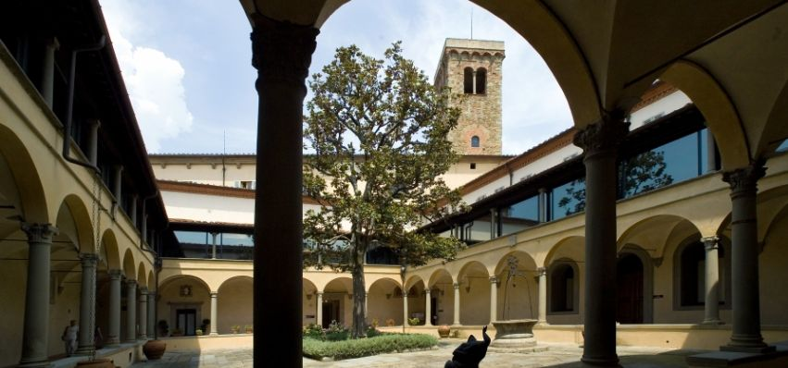
European University Institute
The EUI is a European academic institution, established in 1972 by six Member States: Belgium, France, Germany, Italy, Luxembourg and the Netherlands.
The EUI has currently 23 Member States: Austria, Belgium, Bulgaria, Cyprus, Denmark, Estonia, Finland, France, Germany, Greece, Ireland, Italy, Latvia, Luxembourg, Malta, the Netherlands, Poland, Portugal, Romania, Slovakia, Slovenia, Spain, Sweden.
The EUI works as an international organization; a separate organization from the European Union.
The EUI promotes post-graduate studies and research in social sciences (i.e. law, economics, history and political science).

Slide 3
European University Institute
School of Transnational Governance
4 Departments
PhD students
RSCAS
Inter-disciplinary research
Max Weber
programme
post-doc
researchers
EU Historical Archives
Migration
Florence Competition Programme (FCP)
Global Governance
Centre for Media Pluralism
and Media Freedom (CMPF)
Competition Policy and Market Regulation
EUI Institutions and Democracy
Florence School of Regulation
- Communications & Media
(FSR C&M)

Slide 4
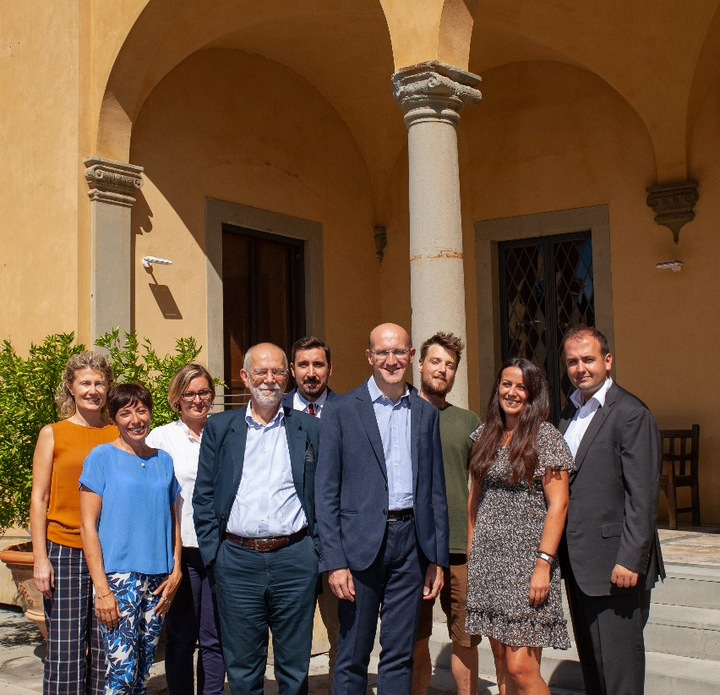
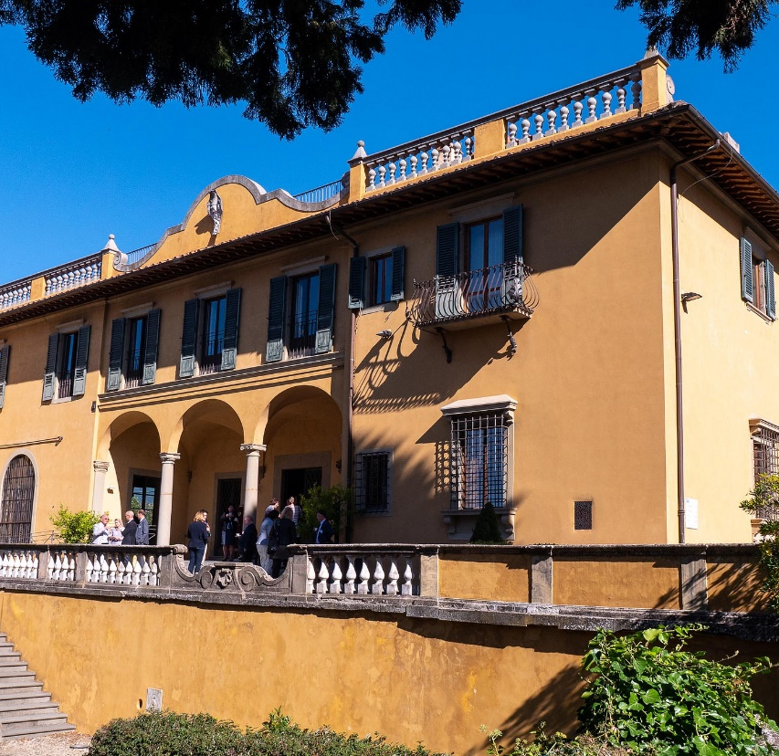



TEAM
Residential team in Florence
Scientific Committee
INSTITUATIONAL PARTNERS
MARKET DONORS
Industry
Law firms
Economic consultancies

Slide 5
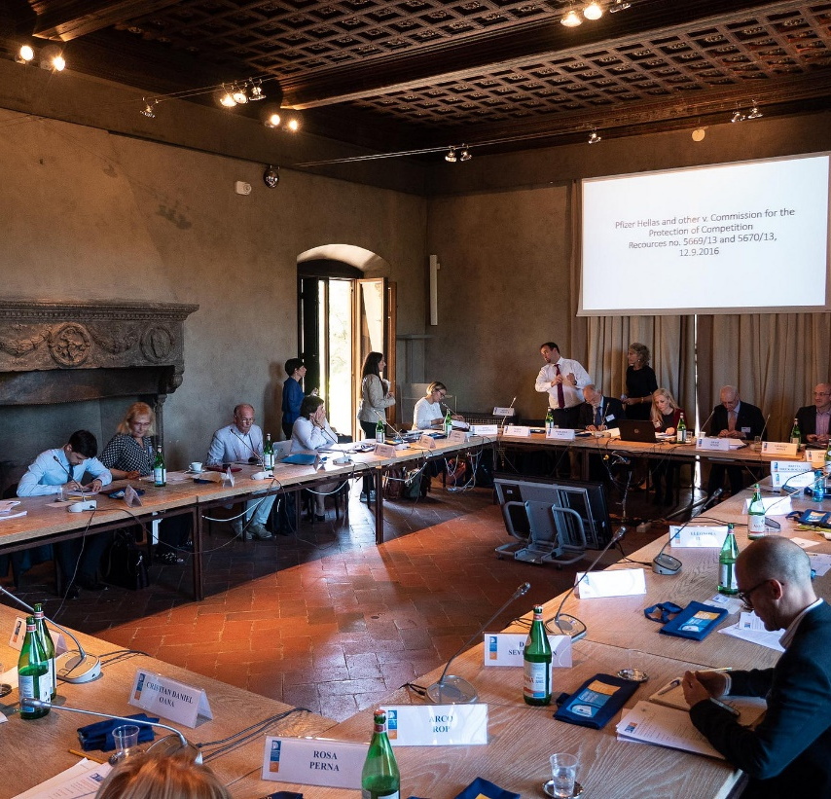
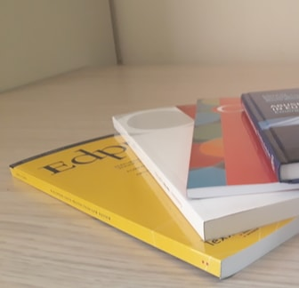



Former trainings participants
TRAINING
Florence Competition Autumn School, 3-7 Oct. 2021.
Online trainings
Ad-hoc trainings
POLICY
RESEARCH
Autumn Conference (8.10.2021)
Annual Scientific Seminar
Policy Briefs
ENTraNCE books, edited by Parcu, Monti, Botta
Florence Competition Programme

Slide 6
Todays’ conference
  4th conference jointly organized with Assonime.
  Hybrid conference: Florence + Zoom.
  Relevance: contribution to the on-going policy debate on the revision of the EU Commission guidelines/block exemptions regulations:
    Market definition.
    Horizontal cooperation agreements.
    Vertical agreements.

Slide 7
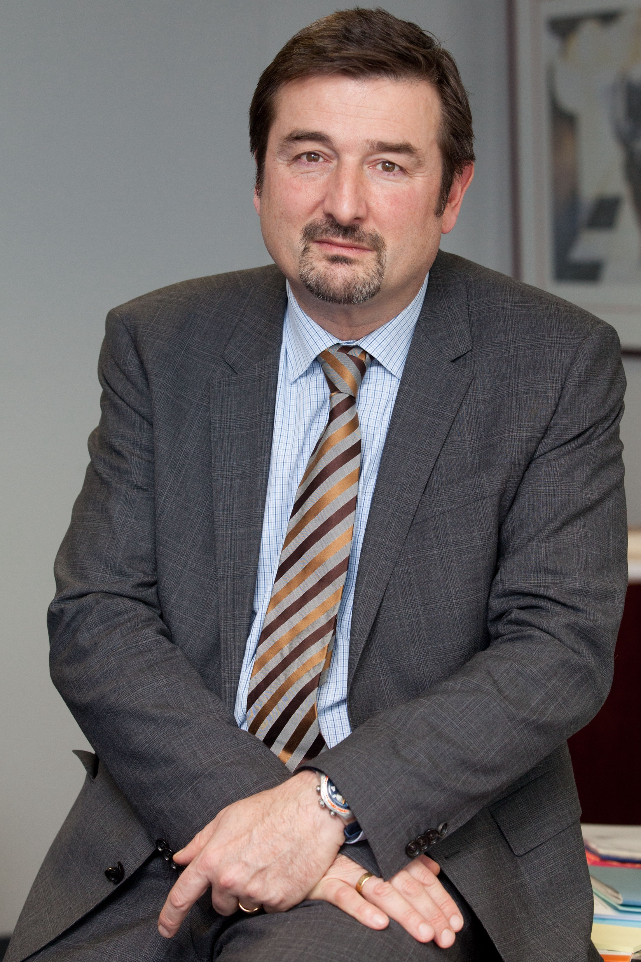
Todays’ conference - structure
  Key-note speech by Olivier Guersent,
  Director General, DG Competition
  9.15 – 10.15 CEST
Panel 1 (10.15 – 12.30): Revision of the Market Definition Notice.
Panel 2 (14.00 – 15.30): Revision of the Rules on Horizontal Cooperation Agreements.
Panel 3 (16.00 – 17.30): Revision of the Rules on Vertical Agreements.
CEST – Central European Summer Time

Slide 8
Today’s conference - instructions
Broadcasting:
Key-note speech by Director-General Guersent is broadcasted via YouTube + Zoom.
Panels will be broadcasted only via Zoom. Registered participants can:
a) Ask questions to the panelists via the chat box ➣ NO microphone and camera.
b) Reply to the poll questions.
After the conference: video recordings will be available on the event webpage.

Slide 9



Thank you for the attention!
@PLParcu
linkedin.com/in/pier-luigi-parcu

